Slide 1
COE 381: MICROPROCESSORS Group 18
TOPIC :
MICROCONTROLLER BASED WATER TANK LEVEL MONITORING , FILLING AND TURBINE CONTROL SYSTEM

Slide 2
Group Members
Natasha Enyonam Kpodo-Eglu – 7327423
Nana Seguwa Enyimnyam Ephraim – 7323523
Fosu Oscar Ababio – 7324023
Gyamera-Temeng Alan Kwabena – 7325023
Dadebo Basil Nartey Mawulom Kojo – 7321623
Kpegah Wilmer Seyram – 7327223
Boateng Osborn – 7320923
Padikie Claudia Nyauyo Lartey – 7328323
Darko Ronald – 7322023

Slide 3
OUTLINE OF PRESENTATION
Introduction
Problem Statement
Methodology
Demonstration/Simulation
Conclusion

Slide 4
Introduction
Water management is a critical challenge in both residential and industrial environments
Manual monitoring of water levels often leads to wastage, overflow, or shortage.
This project presents an automated system that monitors water levels, controls tank filling, and manages a turbine system using a microcontroller.
The aim is to improve efficiency, reduce human intervention, and optimize water usage

Slide 5
Problem Statement
Many water tank systems rely on manual operation, which can lead to:
Water overflow due to lack of monitoring
Dry running of pumps causing damage
Inefficient water usage
Lack of integration with energy-generating systems like turbines
This project seeks to design a system that automatically:
Monitors water levels
Controls pump operation (filling)
Activates a turbine based on water flow

Slide 6
Components
Arduino Uno HR Motor Driver
Breadboard
Ultrasonic sensor
Motor
Buzzer
Jumpers
Resistor
LED

Slide 7
METHODOLOGY
We used an ultrasonic sensor to detect movement of the level of the rising water.
When the water level is almost to the brim of the tank, the sensor detects and trips off the buzzer and red LED, causing an alarm to notify the user.
The motor was used to represent the pump.

Slide 8
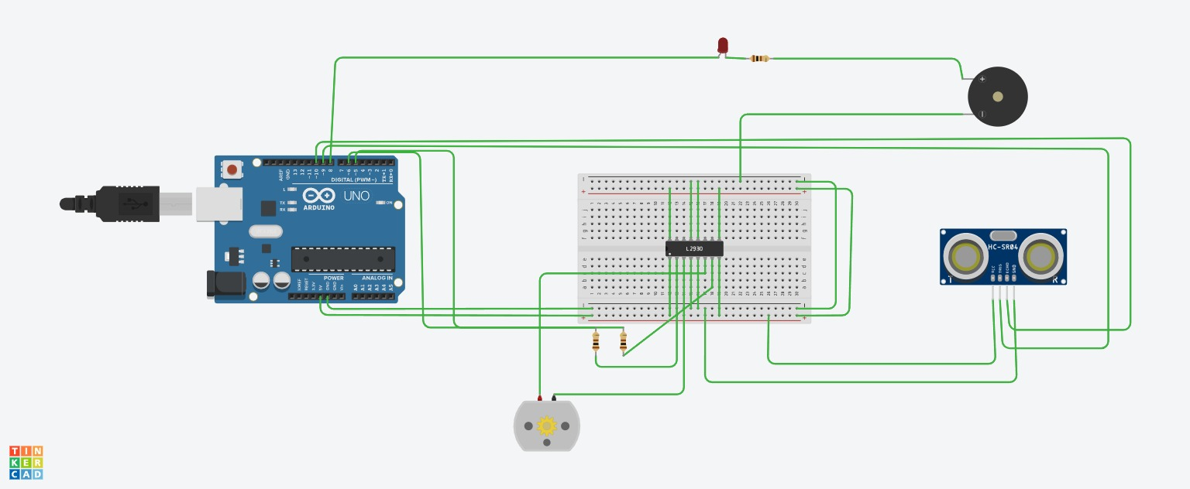
Demonstration / Simulation

Slide 9
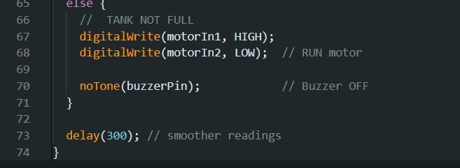
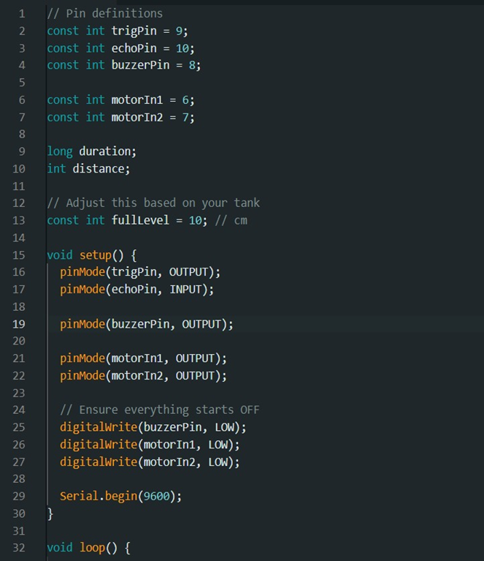
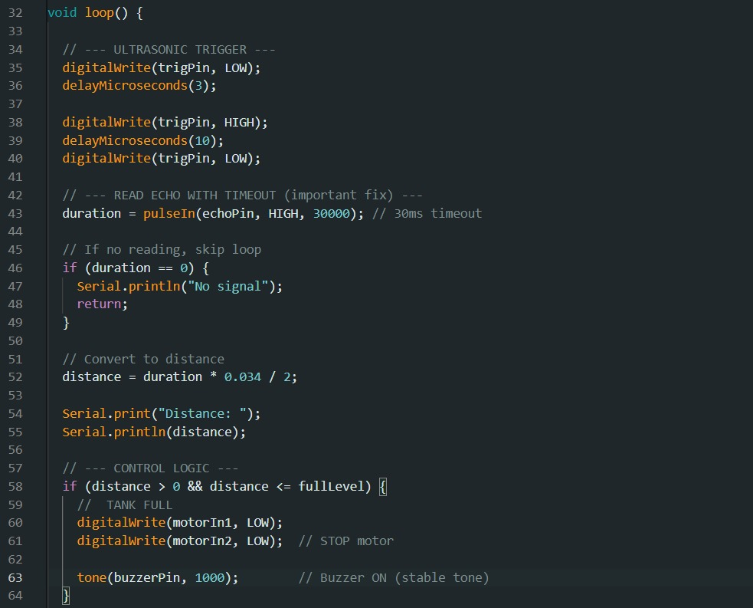
Overview of Codes

Slide 10
Conclusion
SUMMARY;
Once the sensor detects water, the Buzzer sounds indicating that the tank is full and the motor automatically shuts down to prevent additional pumping.
This improves efficiency and prevents overflow of tanks, leading to wastage of water.

Slide 11
THANK YOU

